Slide 1

BMI 6319 Midterm Proposal
Voice-Based Screening of Parkinson’s Disease Using Clustered Acoustic Features
Uday Pratap Singh, BDS, MDS, PhD Student
Primary Mentor:
Xiaoqian Jiang, PhD
Data Source:
Bridge2AI Voice Dataset (PhysioNet)
Proposal Type:
Methods-focused, reproducible machine-learning study for clinical screening
Date:
01/28/2026

Slide 2
High-Level Overview & Aims
Motivation
Parkinson’s disease affects vocal motor control early, leading to subtle, distributed speech changes that can precede clinical diagnosis.
Voice-based screening is non-invasive and scalable, but many existing studies rely on small datasets and limited acoustic feature sets, restricting robustness.
Prior models often prioritize predictive accuracy over explainability and patient-level generalization, limiting their clinical and biomarker relevance.
Overall Objectives
Develop a reproducible, voice-only machine learning pipeline that
improves patient-level Parkinson’s screening using cluster-aggregated features, and
reveals meaningful acoustic clusters to support future vocal biomarker discovery.

Slide 3
Team Members
Principal Investigator / Lead Analyst
Uday Pratap Singh, BDS, MDS
PhD Student & Graduate Research Assistant
Biomedical Informatics, UTHealth Houston
Faculty Mentor
Xiaoqian Jiang, PhD
Professor of Biomedical Informatics
UTHealth Houston
Clinical Lead (Neurology)
Sean I. Savitz, MD
Professor of Neurology
UTHealth Houston
Speech & Voice Domain Expert
Heather Smith, MA, CCC-SLP, CBIS
Speech-Language Pathologist

Slide 4
Plain Language Narrative
Parkinson’s disease affects vocal motor control early in its course, leading to subtle and distributed changes in speech that may precede clinical diagnosis. While voice-based screening is non-invasive and scalable, existing approaches often rely on small datasets, limited acoustic features, and recording-level evaluation, with limited insight into which speech characteristics are most informative.
In this study, we developed a voice-only, reproducible analysis framework that explicitly examines the structure of acoustic features rather than treating them as independent variables. We analyzed correlations among acoustic features to identify coherent feature clusters, aggregated these clusters into compact representations, and evaluated their utility for patient-level Parkinson’s disease screening.
By focusing on feature interactions and interpretability, rather than only predictive accuracy, this work aims to improve robustness and to provide a foundation for identifying meaningful vocal biomarker groups that can support future clinical and translational research.

Slide 5
Innovation
Feature-cluster–centric perspective
Instead of selecting or ranking individual acoustic features, we explicitly learn and analyze coherent acoustic feature clusters, treating them as fundamental units of information.
Interpretable, structured dimensionality reduction
Correlation-based clustering enables substantial feature compression while preserving interpretable acoustic domains grounded in speech physiology.
Patient-level, voice-only screening framework
The pipeline is designed for patient-level aggregation using voice data alone, aligning with real-world screening scenarios and minimizing reliance on confounding phenotype variables.
Biomarker-oriented modeling beyond classification
By characterizing and evaluating acoustic feature clusters, the approach supports identification of candidate vocal biomarker families, rather than relying on opaque, high-dimensional models.

Slide 6
Dataset Overview
Data Source: Bridge2AI Voice Dataset (PhysioNet)
Scope: Large, ethically sourced voice dataset linked to health information
Size: 19,000+ voice recordings collected from a diverse participant population
Data Collection: Standardized speech recordings collected using well-defined, consistent tasks across the entire dataset
Annotations: Diagnostic labels, task metadata, and selected phenotype information

Slide 7
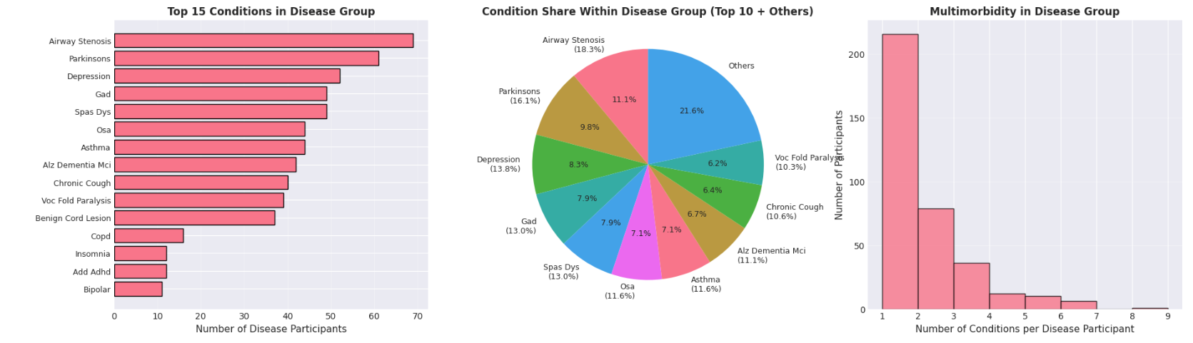
Phenotypes in the Dataset

Slide 8
Dimensionality and Embedding Insights
Linear embedding (PCA):
Variance is distributed across many components
No small set of dimensions captures most of the information
Non-linear embedding (UMAP):
Speech samples form multiple local structures rather than a single cluster
Parkinson’s and control recordings are intermixed, with no clean global separation
Key Insight:
Parkinson’s-related voice differences are subtle and distributed across the feature space
Effective models must integrate multiple weak signals, not rely on a few dominant features

Slide 9
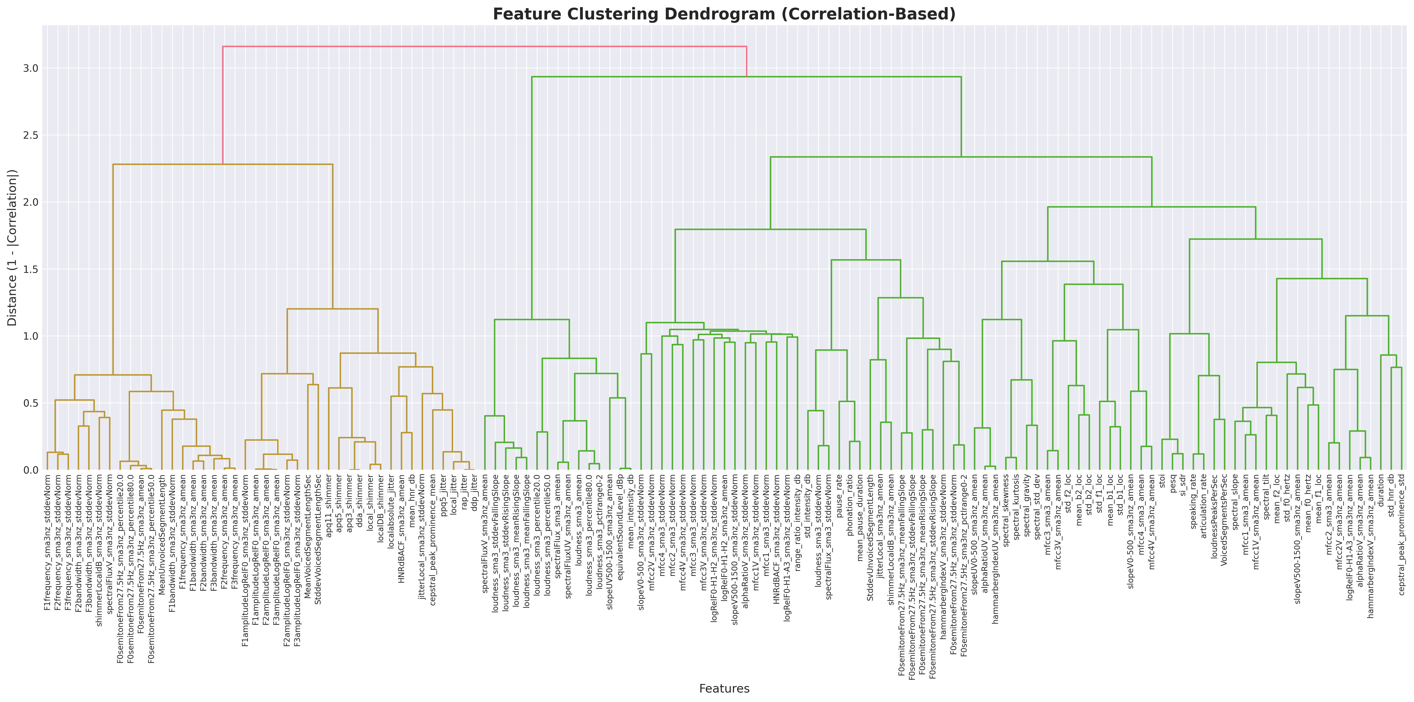
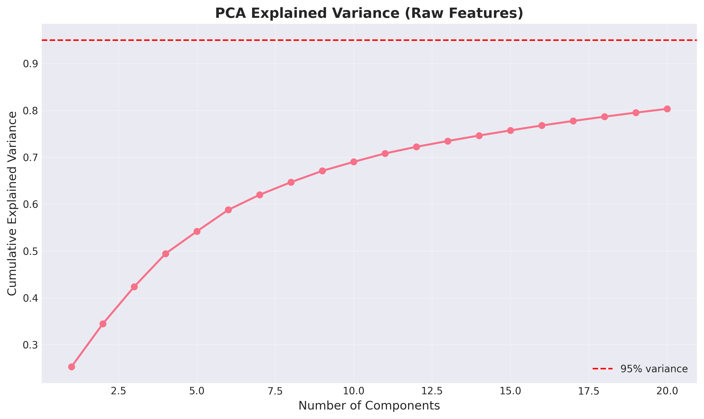
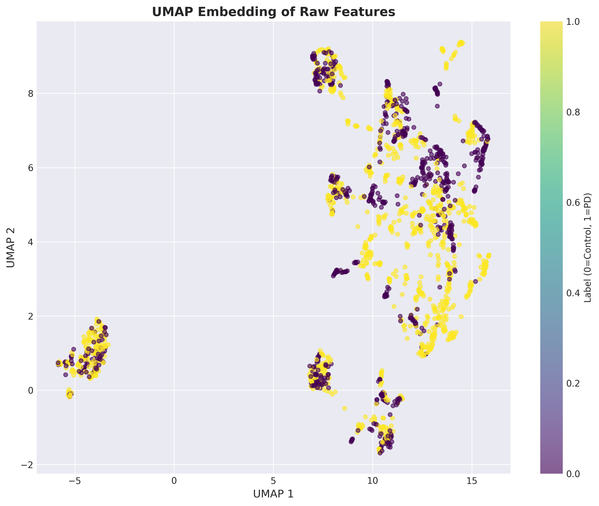
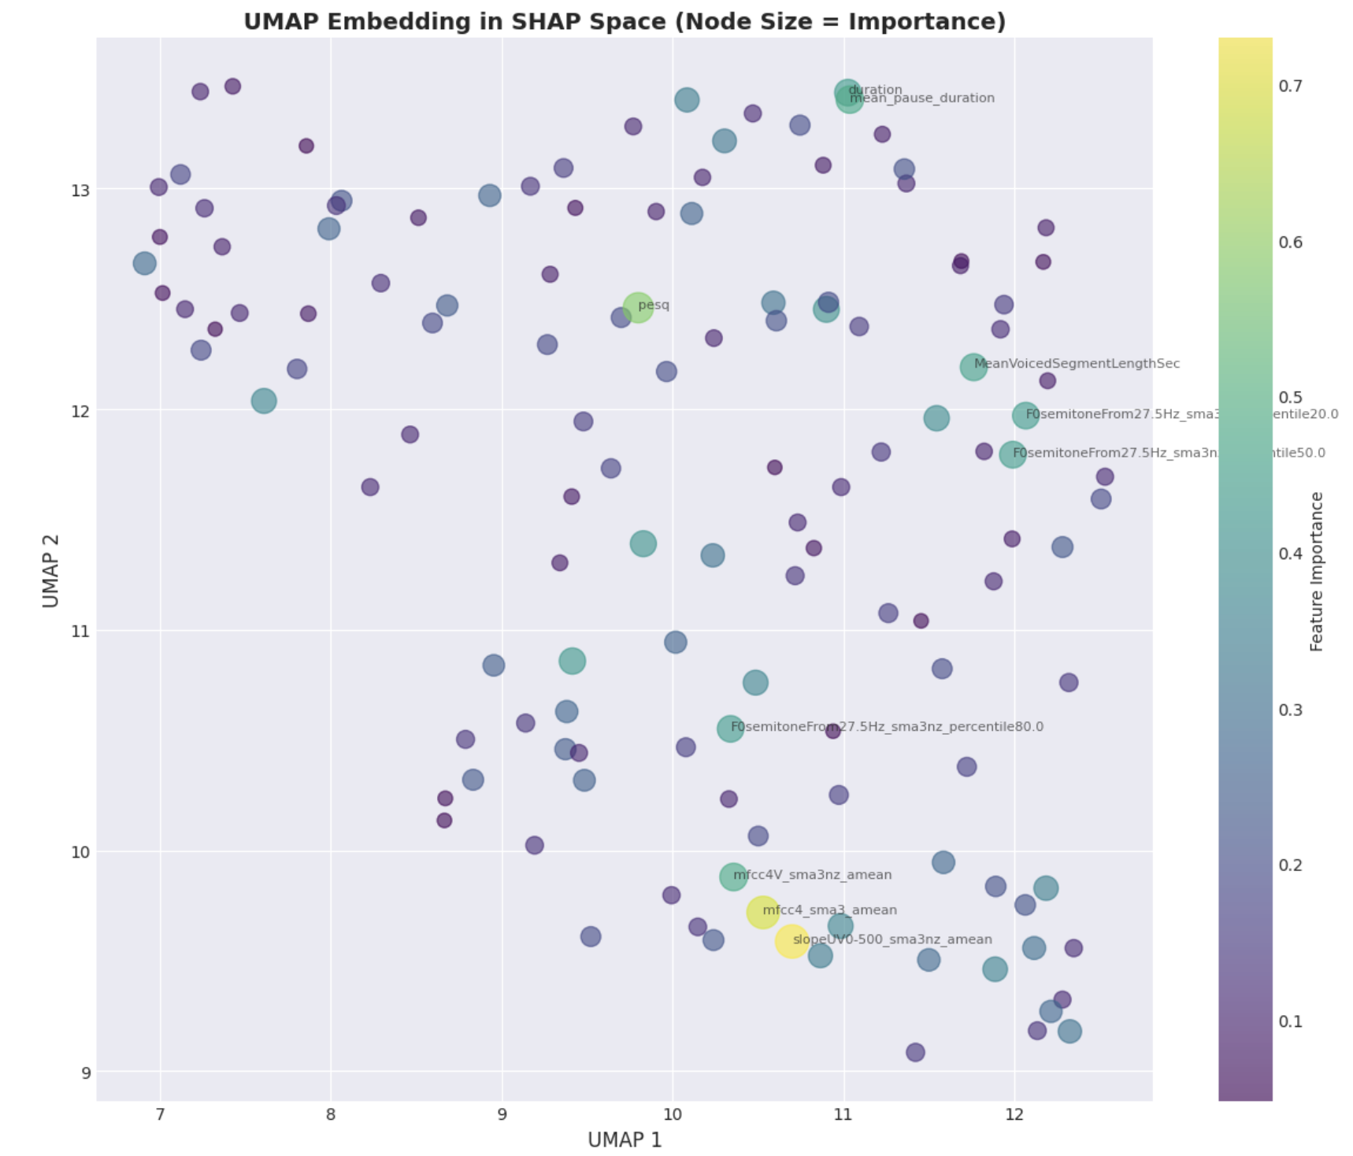
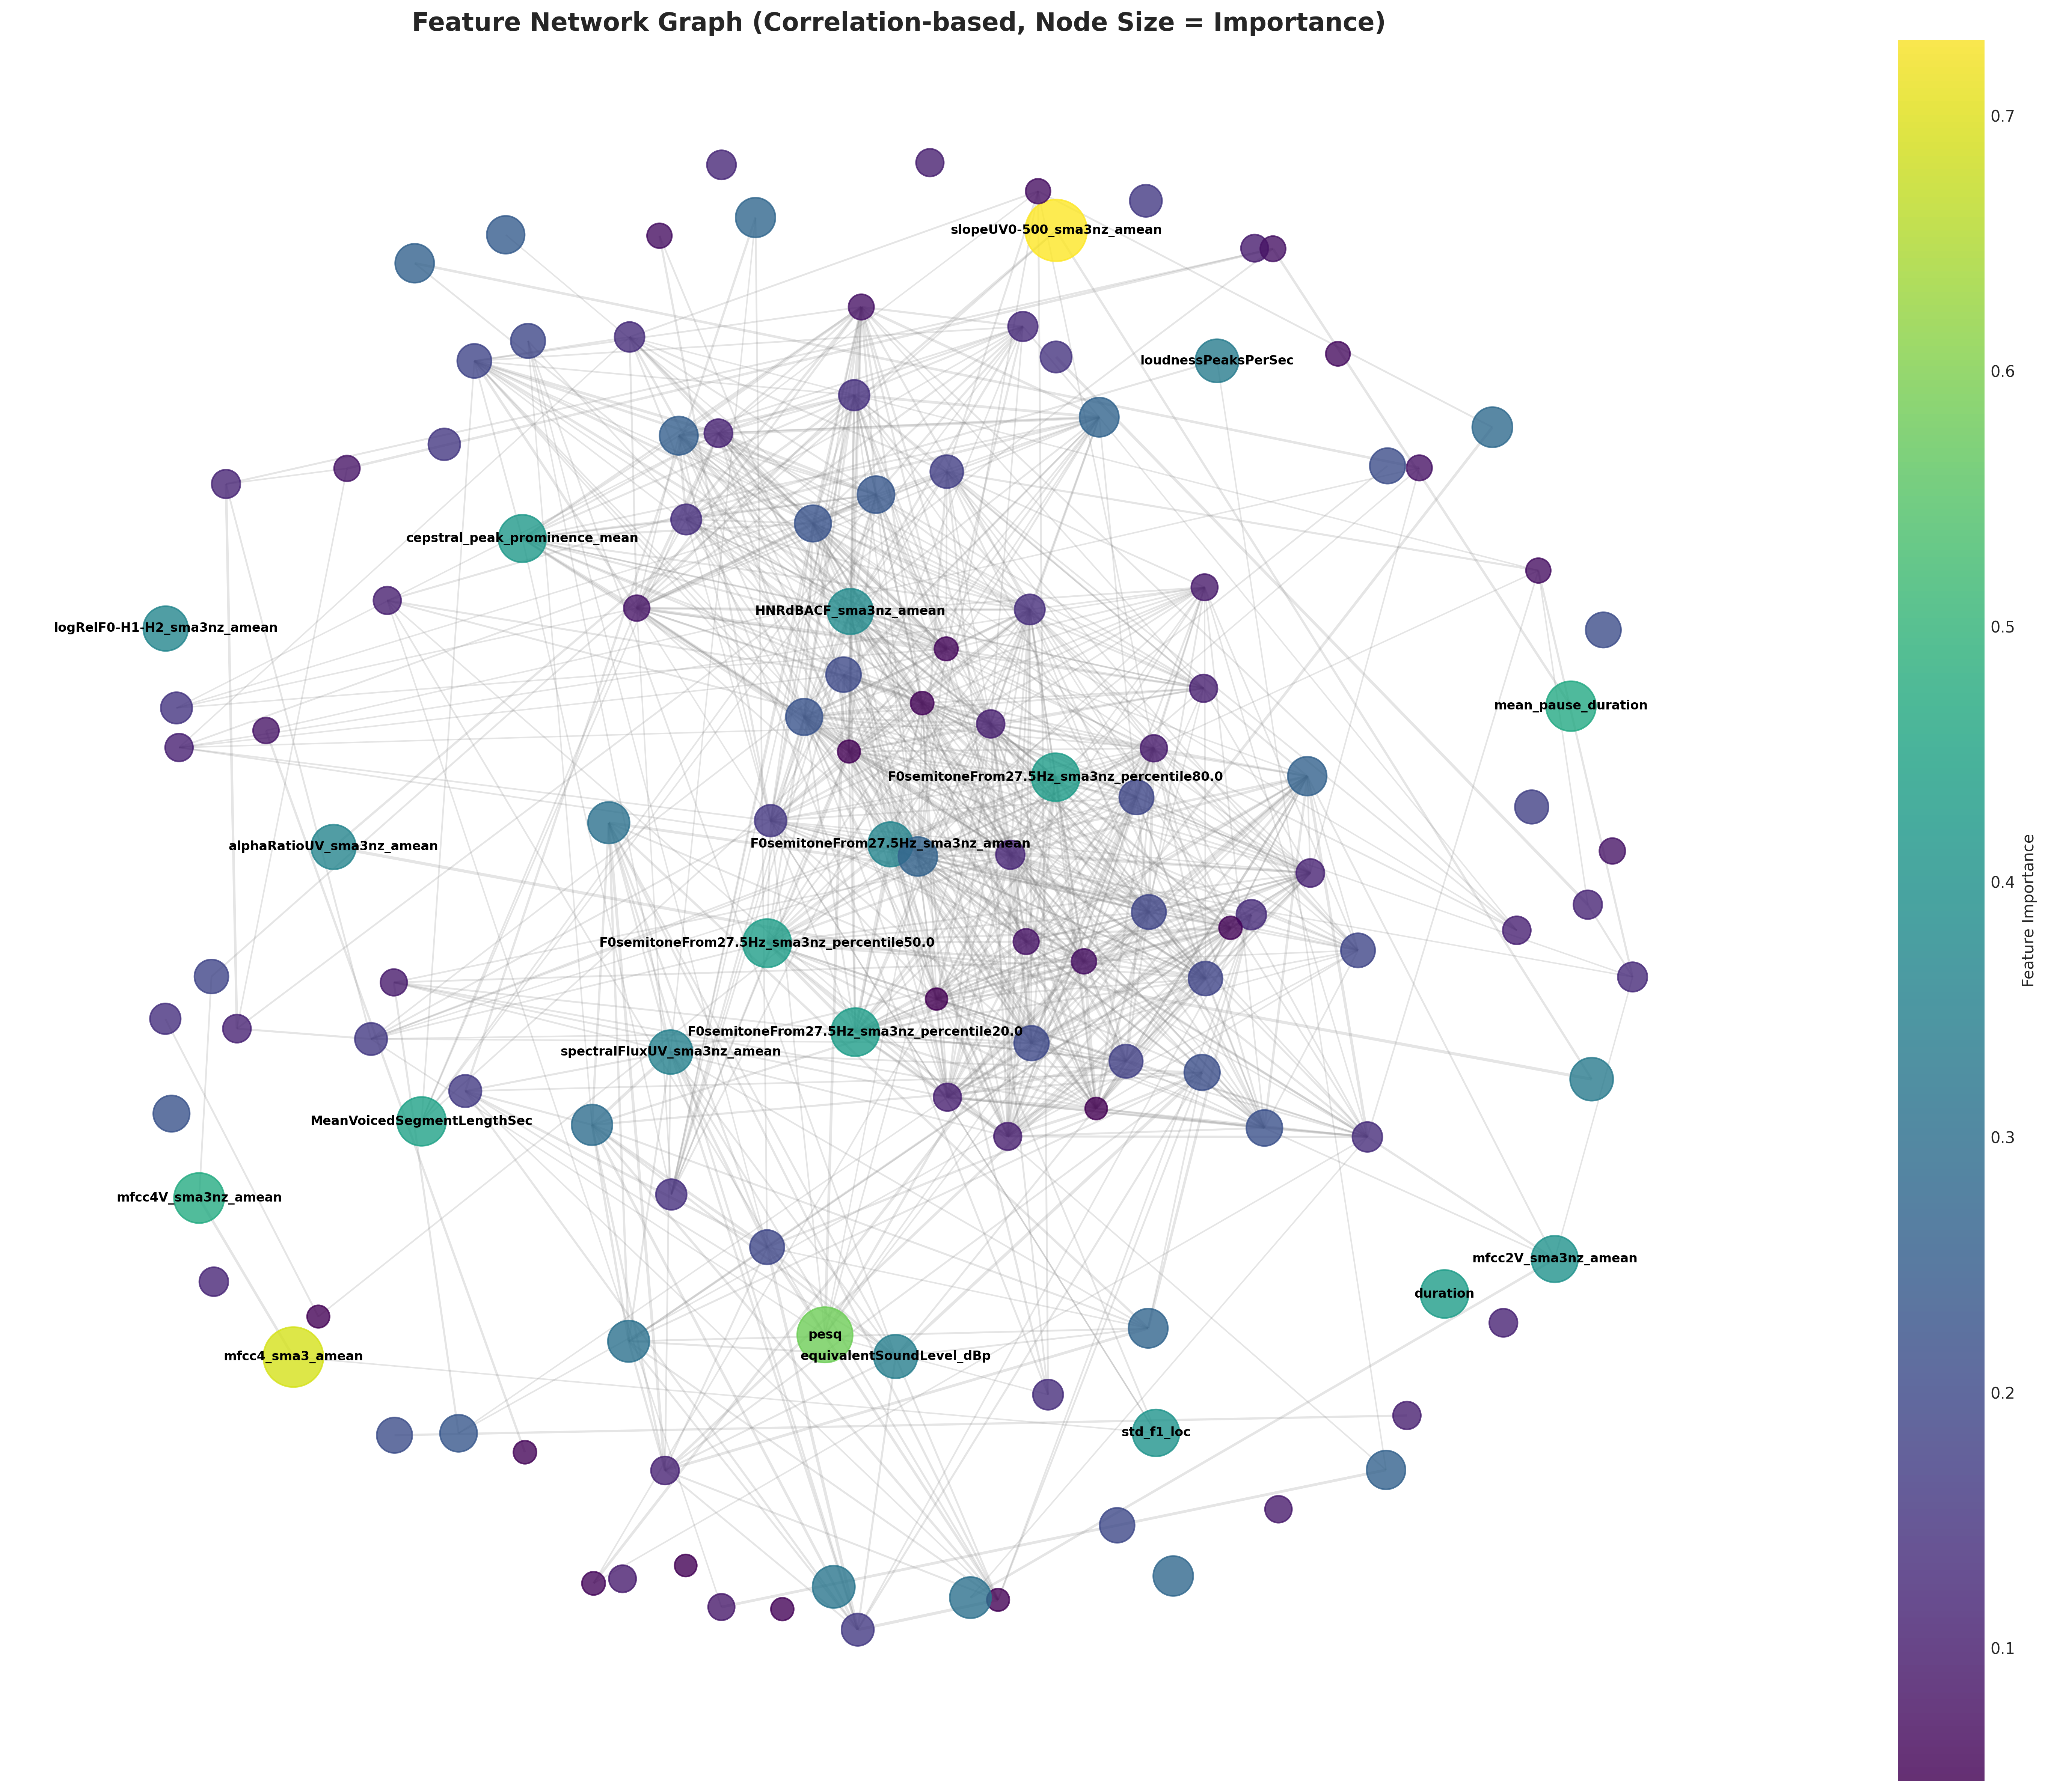

Slide 10
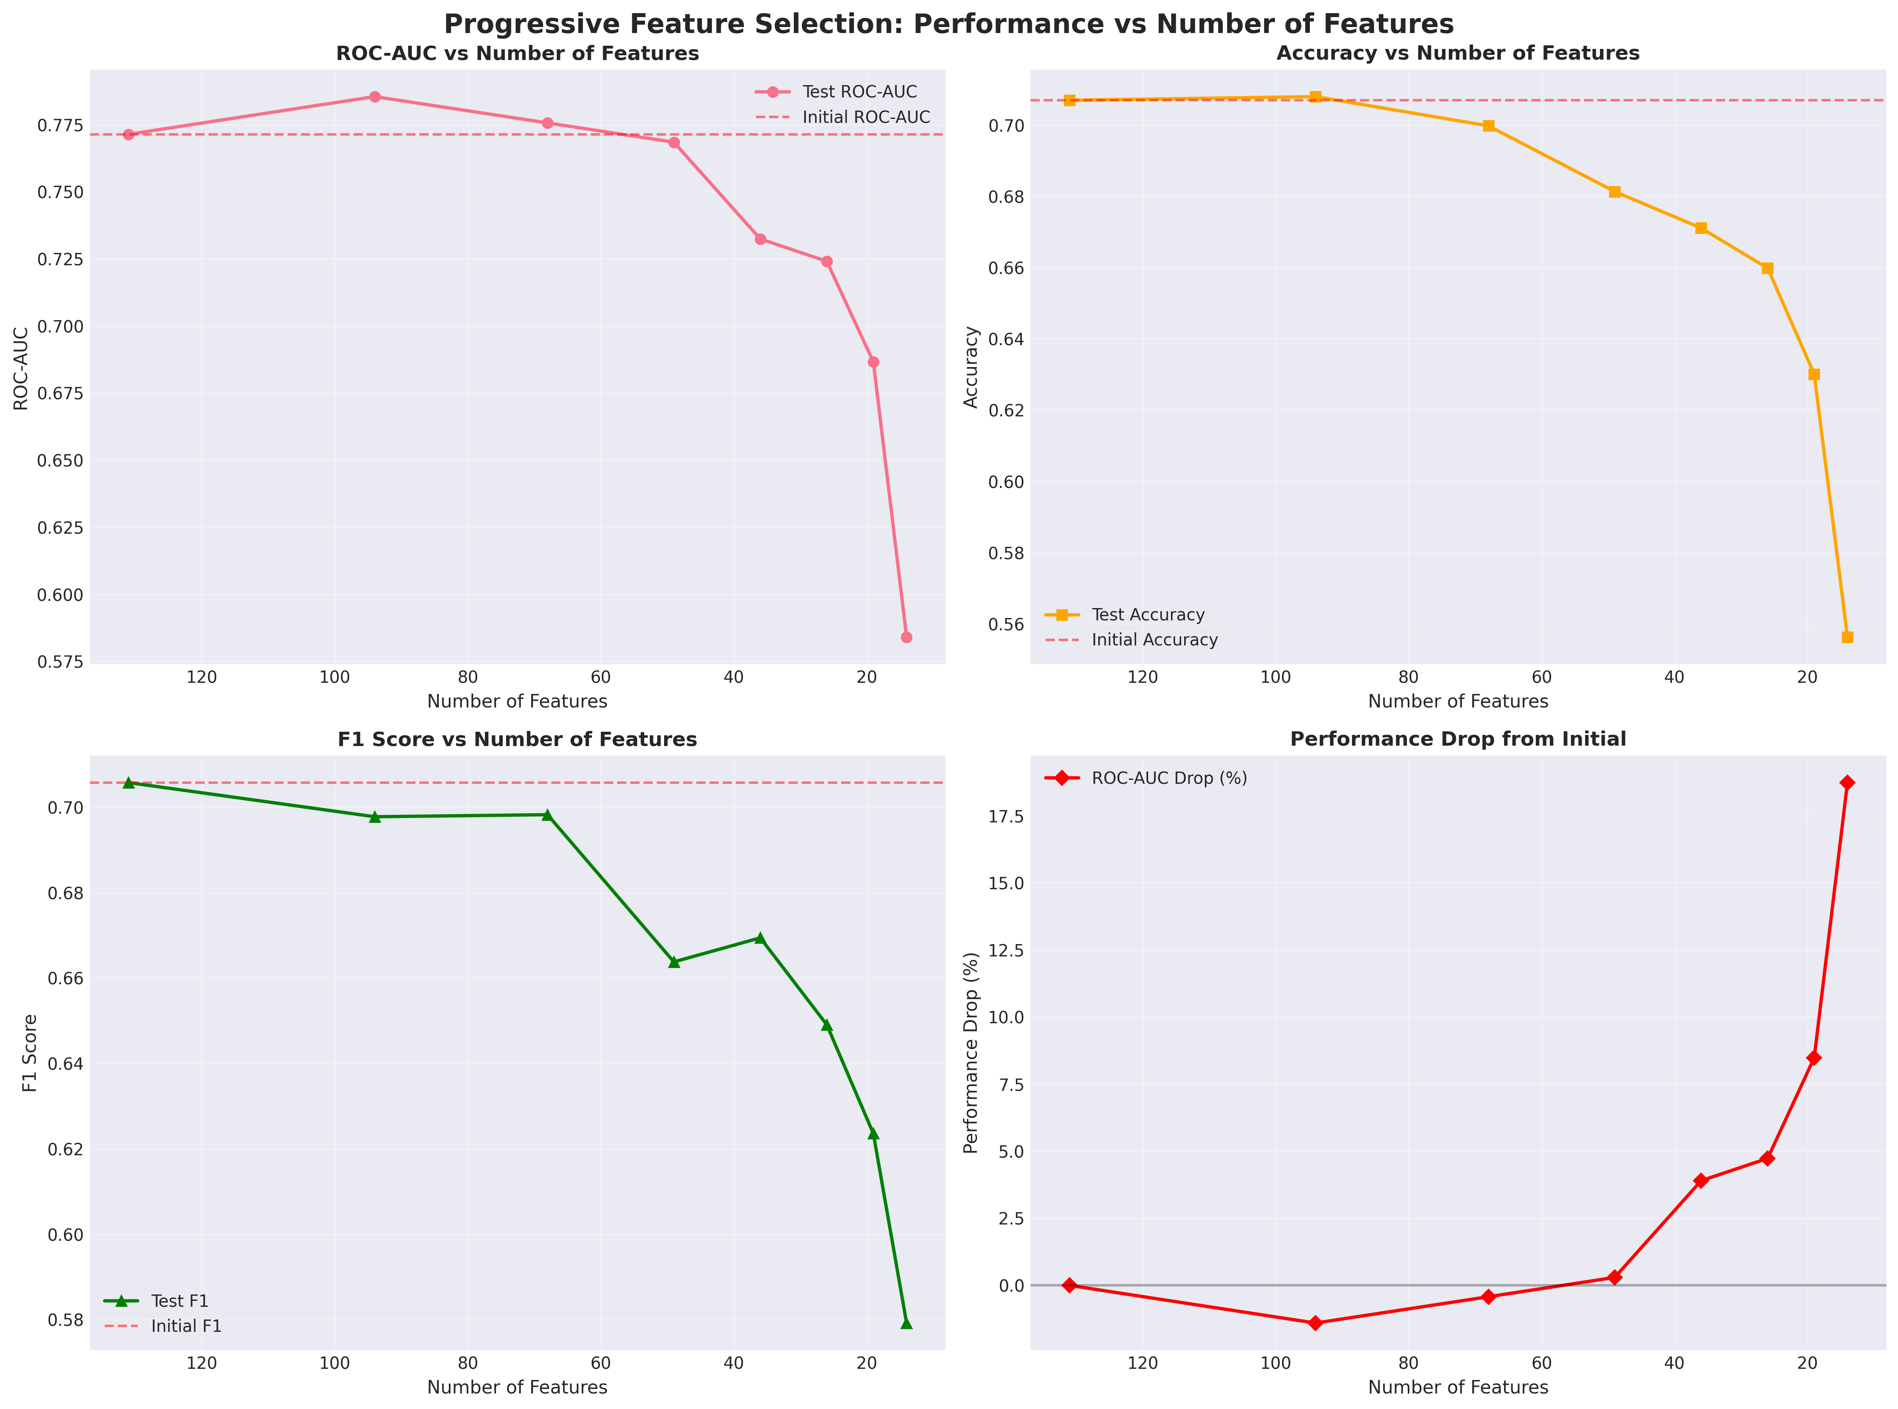
Progressive Feature Selection
As expected, retaining the most important features sequentially does not improve the model and performance keeps deteriorating.

Slide 11
Insights
PCA: Variance is spread across many dimensions → no simple compression
Raw-feature UMAP: Acoustic heterogeneity dominates over disease labels
SHAP-space UMAP: Predictive signal emerges via distributed, cross-domain feature usage
High-level conclusion: Parkinson’s-related voice differences are subtle, distributed, and context-dependent, requiring models that integrate multiple weak signals rather than relying on dominant acoustic markers.

Slide 12
Overall Analysis Pipeline
Input: Standardized voice recordings → static acoustic features
Feature Structure Analysis: Correlation analysis and hierarchical clustering of acoustic features
Feature Representation: Construction of cluster-aggregated acoustic features
Modeling: Training classical machine learning models on raw and clustered features
Evaluation: Recording-level and patient-level performance assessment
Leakage-aware cross-validation
Interpretation: Analysis of cluster contributions to model predictions

Slide 13
Feature Clustering Methodology
Goal: Identify coherent groups of acoustic features that capture related speech properties
Approach:
Compute pairwise correlations between all acoustic features
Define feature similarity based on absolute correlation
Clustering:
Apply hierarchical clustering to group correlated features
Explore multiple cluster resolutions to capture structure at different granularities
Rationale:
Groups features that move together across recordings
Reduces redundancy while preserving meaningful acoustic relationships

Slide 14
Cluster Aggregation Strategy
Objective: Convert feature clusters into compact, interpretable representations
Method: Aggregate features within each cluster using simple summary statistics
Primary aggregation: mean, alternative aggregations explored (e.g., median, PCA-based summaries)
Output:
Original 131 features → K cluster-level features
Enables controlled dimensionality reduction
Rationale:
Simple aggregation improves stability and interpretability
Avoids overfitting associated with high-dimensional raw features

Slide 15
Model Training and Evaluation Framework
Models Evaluated:
Logistic Regression
Random Forest
Gradient Boosting
Neural Network (regularized)
Training Setup:
Models trained on raw features and cluster-aggregated features
Validation Strategy:
Patient-level separation across training and validation folds
Prevents data leakage from multiple recordings per participant
Data Scenarios
Raw dataset with 131 features
14 feature clusters with different aggregations
Evaluation Levels:
Recording-level performance
Patient-level performance via aggregation across recordings
Performance Metrics:
Primary: ROC-AUC
Secondary: F1 score, accuracy

Slide 16
Baseline Performance
Baseline Models: Trained using the full set of 131 acoustic features
Evaluation: Assessed at both recording level and patient level
Observations:
Recording-level performance appears moderate
Patient-level performance is lower and less stable
Interpretation:
High dimensionality and feature redundancy limit generalization
Baseline models do not fully capture distributed Parkinson’s-related voice patterns
Baseline performance is consistent with prior PD voice literature when evaluated at the patient level.

Slide 17
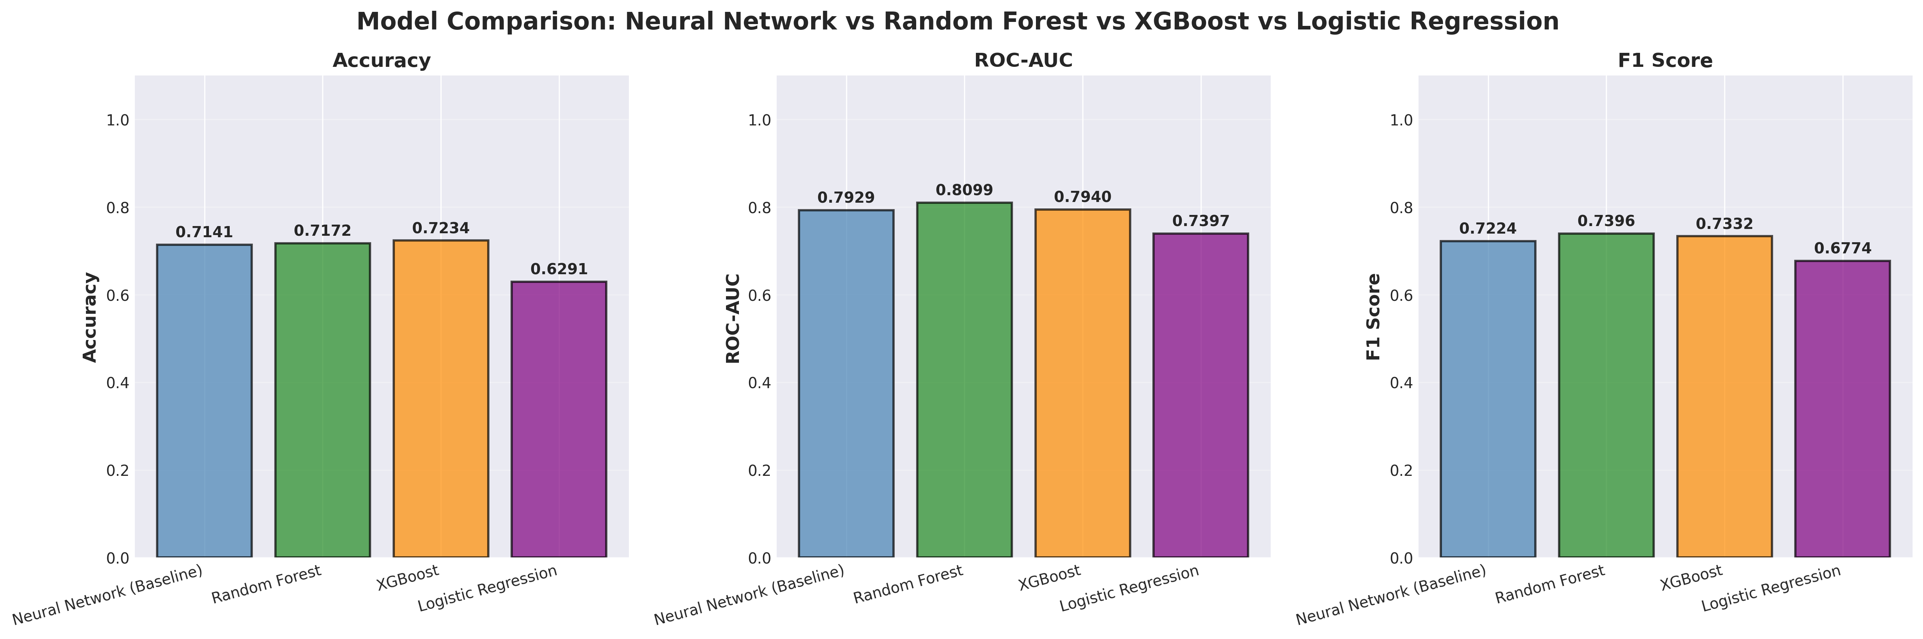
Baseline performance – per recording

Slide 18
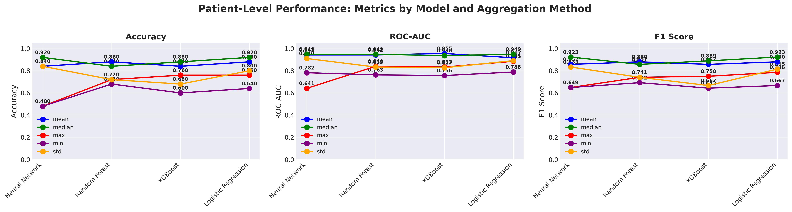
Baseline performance – per patient
Median ~ Mean

Slide 19
Cluster-Aggregated Feature Results
Approach:
Replace 131 raw features with K cluster-aggregated features
Evaluate performance across a range of cluster counts
Key Findings:
Performance improves rapidly as redundant features are consolidated
Peak performance observed at a moderate number of clusters
Little or no gain beyond this range despite increasing dimensionality
Robustness:
Performance trends are consistent across multiple model types
Interpretation:
Aggregating correlated features improves generalization
Parkinson’s-related voice information is captured by feature families, not individual features

Slide 20
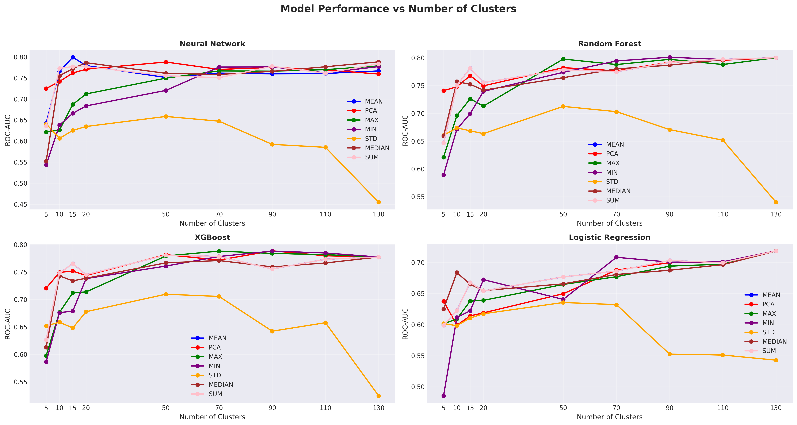
Recording level performance with K clusters

Slide 21
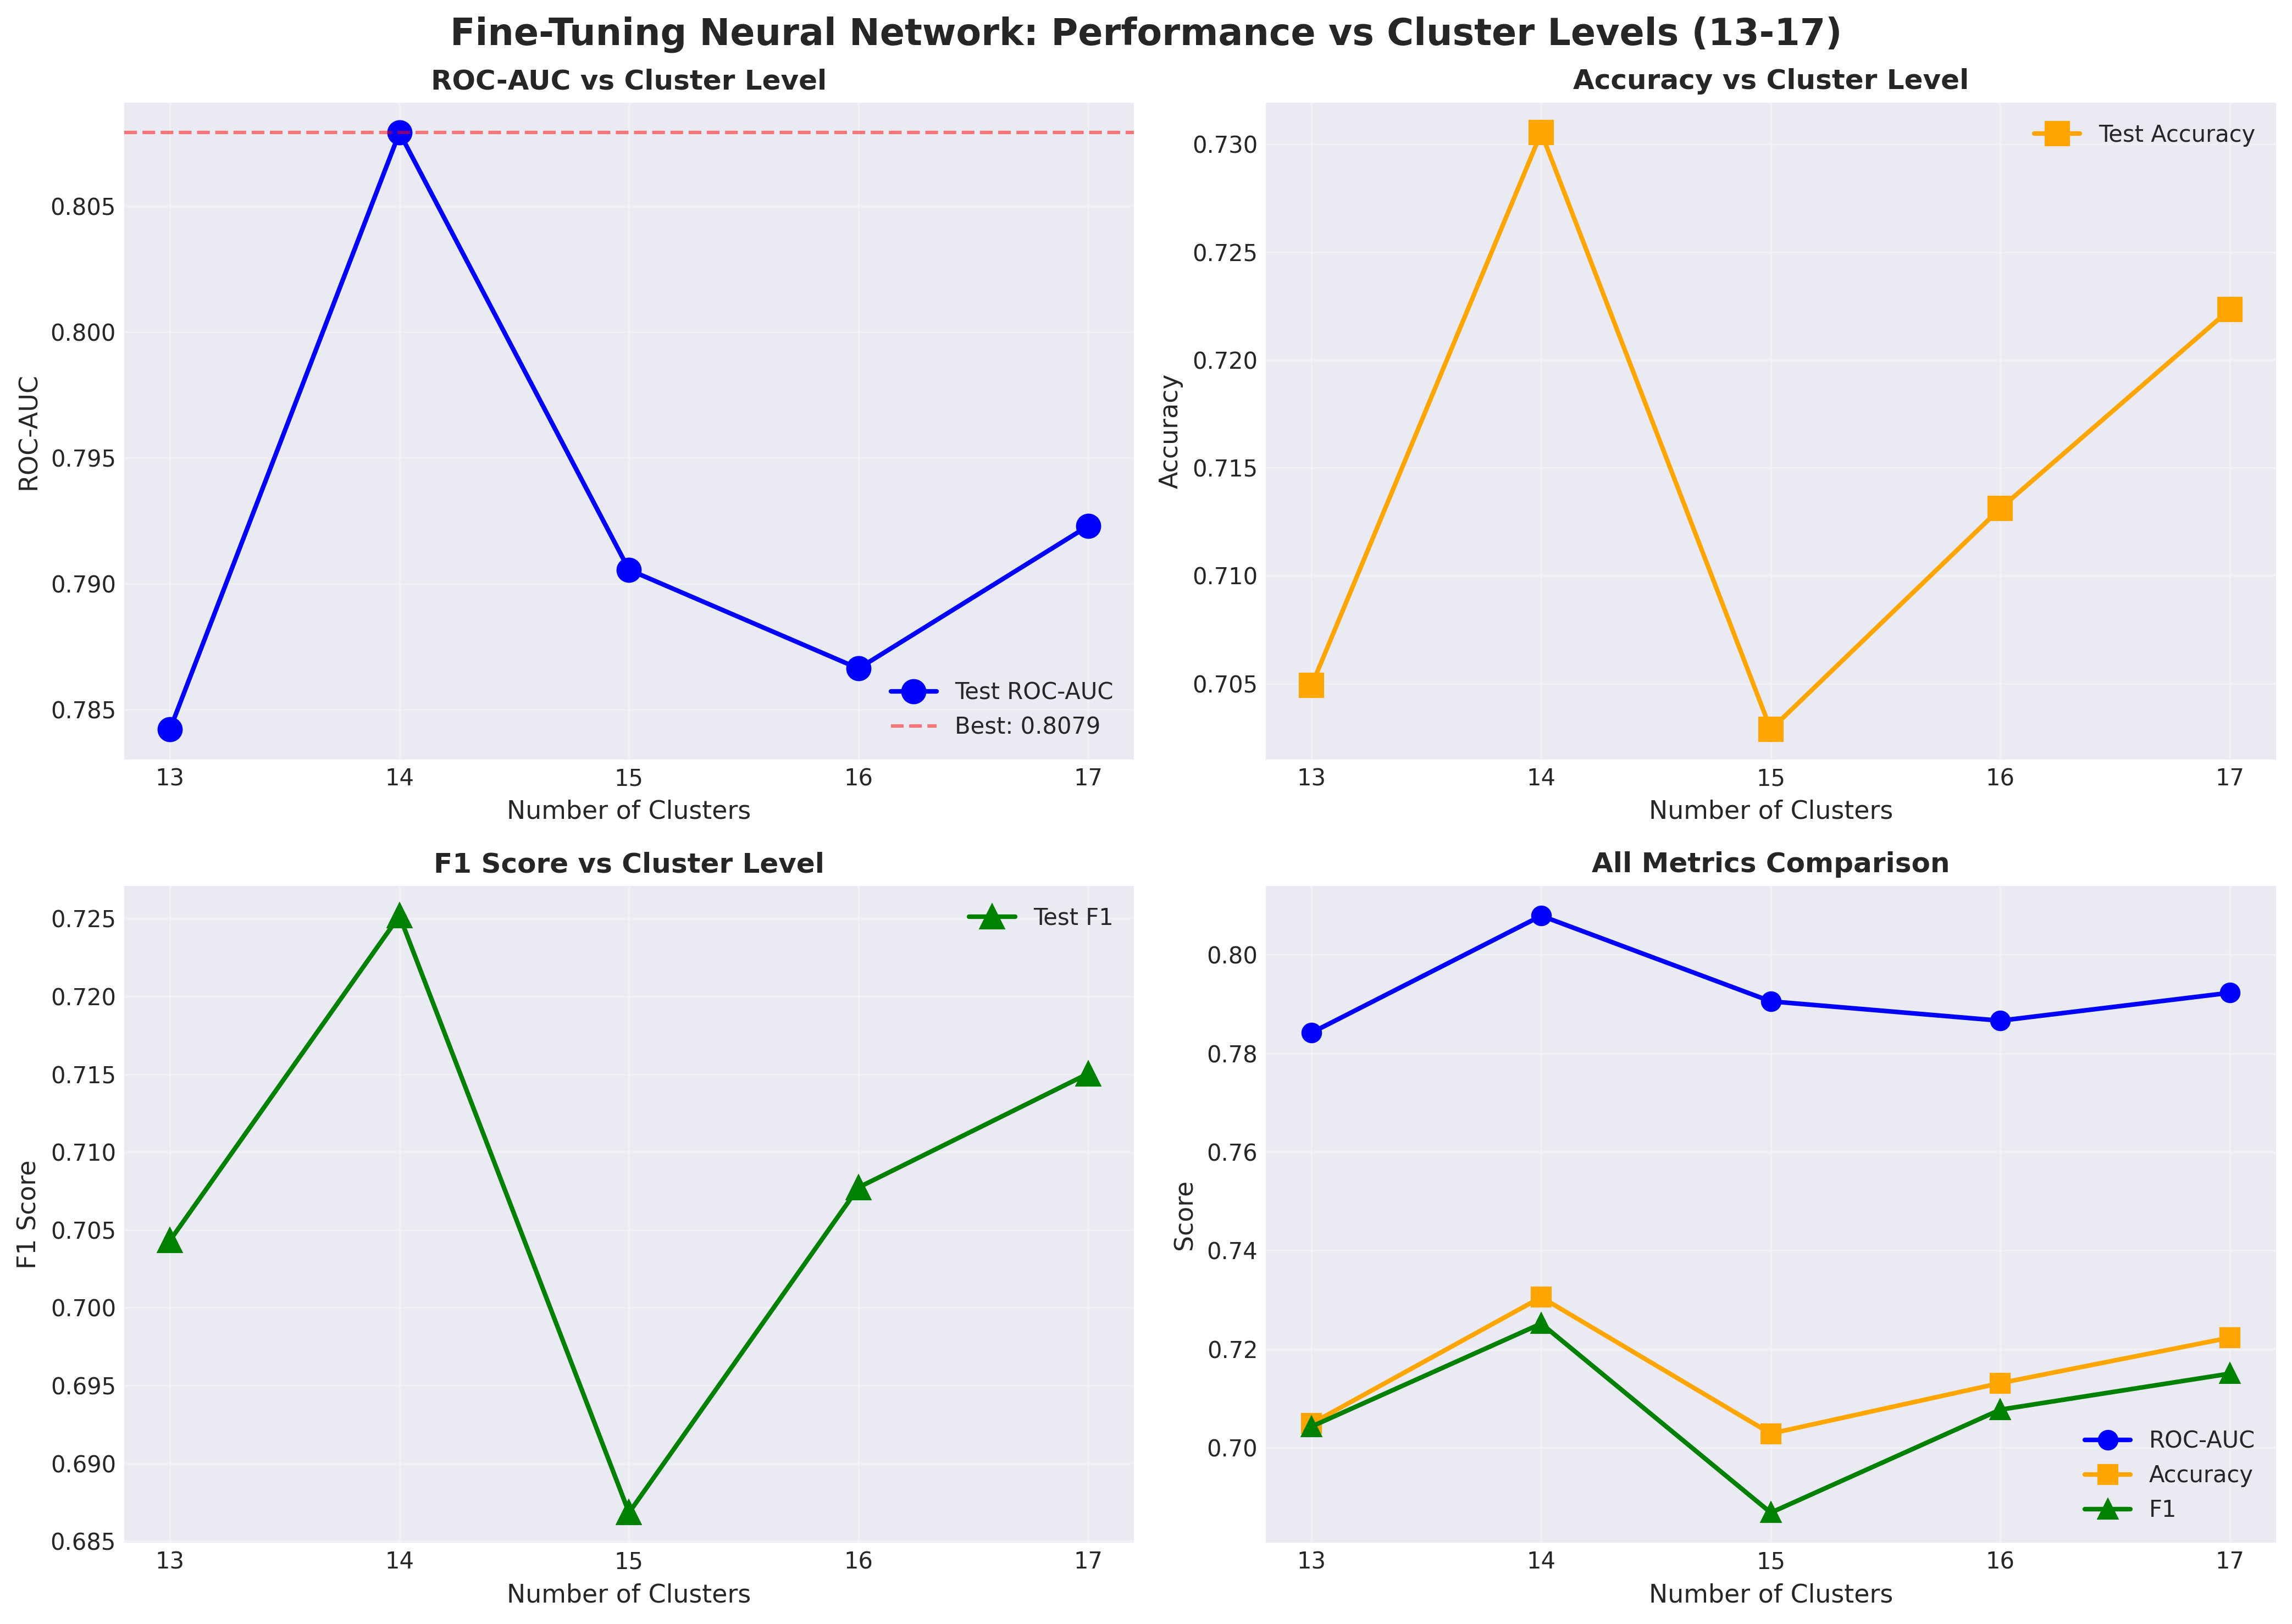
ROC-AUC, accuracy and F1 – all maximized at 14 features
Massive dimensionality reduction with improved generalization.
Aligns with initial feature-clustering insights
A small number of cluster-level features captures most of the discriminative signal, supporting the hypothesis that Parkinson’s voice effects are organized into a limited number of acoustic domains.

Slide 22
Patient-Level Performance
Aggregation Strategy:
Combine multiple recordings per participant using summary statistics
Median aggregation provides the most stable performance
Results:
Cluster-aggregated features achieve improved patient-level discrimination compared to raw features
Performance gains are consistent across models
Key Insight:
Patient-level aggregation reduces noise from individual recordings
Reflects realistic screening scenarios where multiple samples are available
Implication:
Cluster-based representations support more reliable patient-level screening

Slide 23
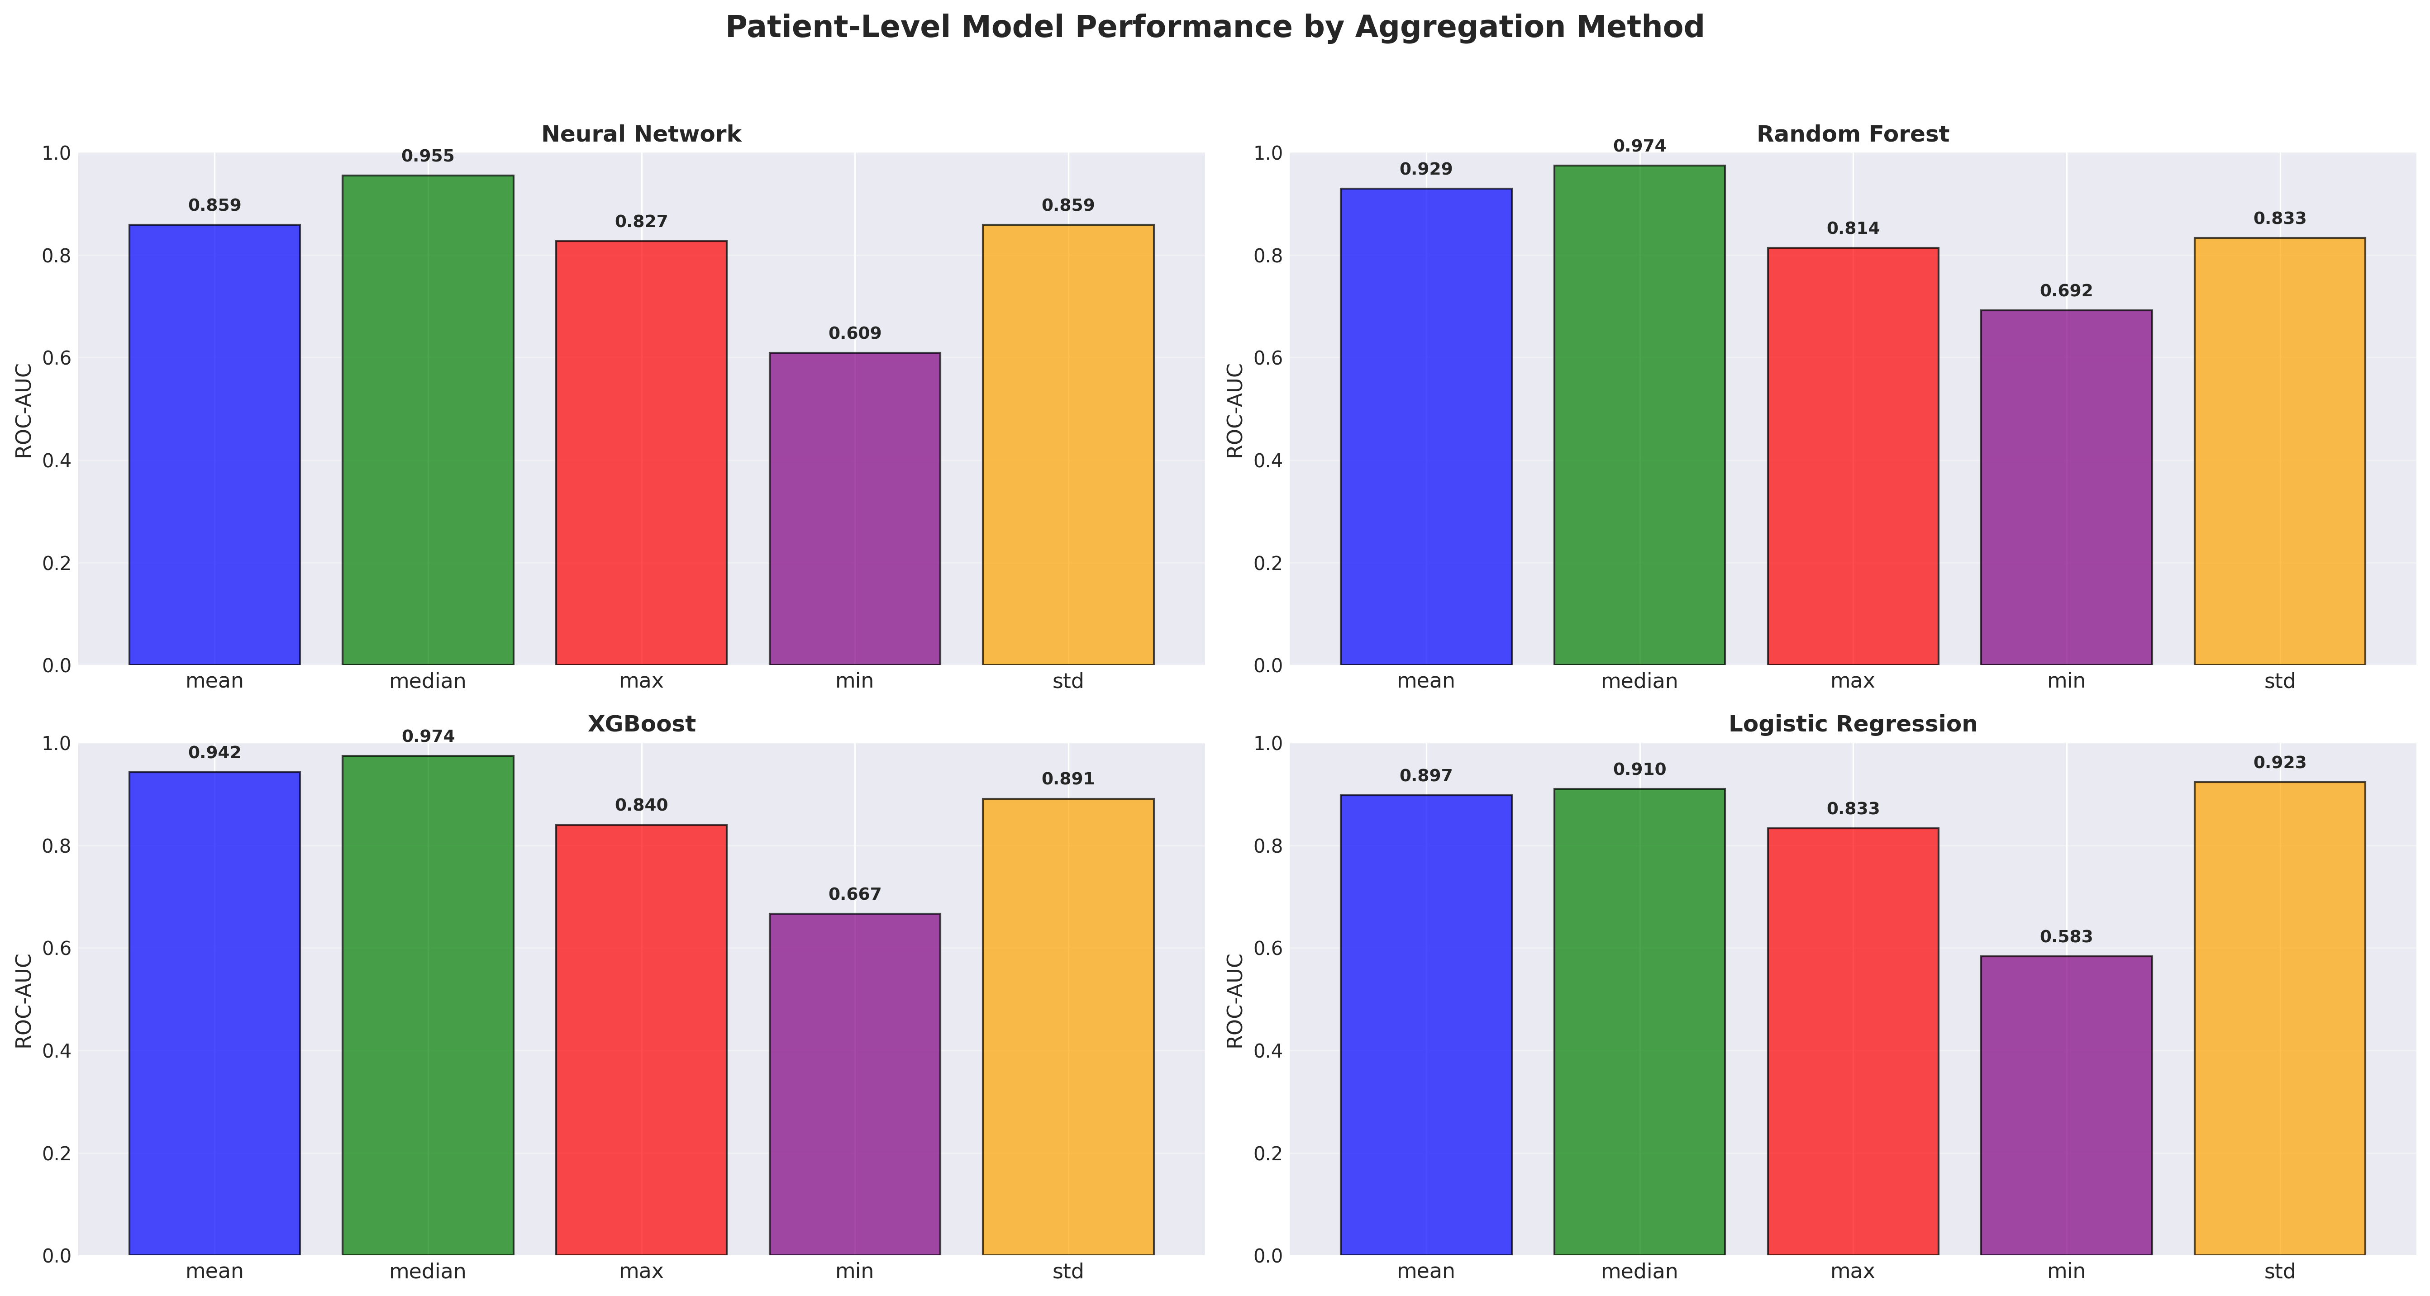
Patient level performance with 14 features (clusters aggregated by mean)
For aggregating cluster values from various recordings for each patient – median works the best across all models.

Slide 24
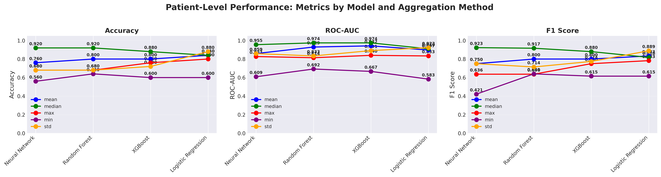
14 clustered features
Baseline, 131 features

Slide 25
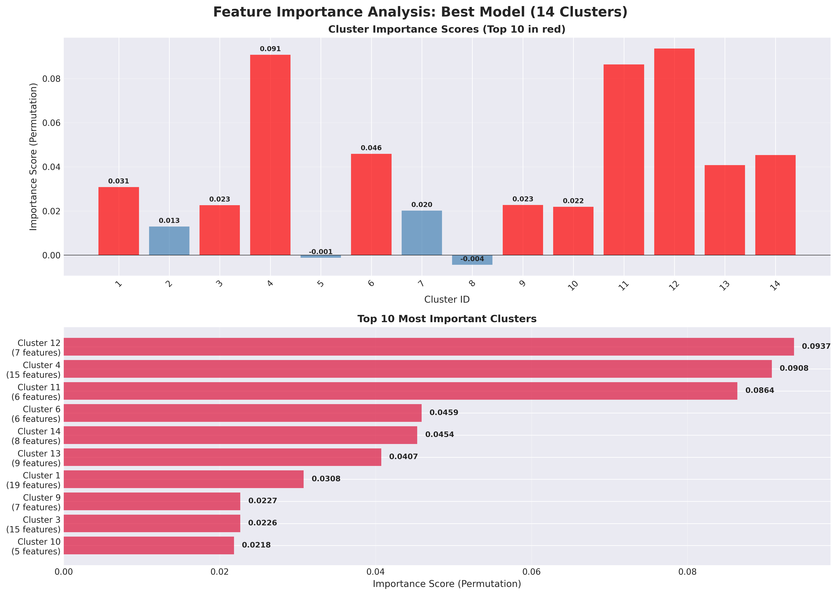

Slide 26
Interpretability and Cluster Characterization
Cluster Interpretation:
Learned clusters correspond to coherent acoustic domains (e.g., speech rate, loudness dynamics, pitch stability, voice quality)
Model Usage:
Models rely on multiple clusters, rather than a single dominant feature group
Distributed Signal:
Parkinson’s-related voice changes emerge from combined effects across clusters
Biomarker Implications:
Cluster-level representations provide a structured path toward vocal biomarker discovery
Enables linking acoustic families to underlying speech and motor processes

Slide 27
Dominant Acoustic Clusters: Speech Rate, Loudness, and Articulation
Cluster 12 — Speech Rate & Intelligibility
Key features:
speaking_rate, articulation_rate, loudnessPeaksPerSec, voicedSegmentsPerSec, STOI, PESQ
What it captures:
Speech tempo, articulation efficiency, and intelligibility
Relevance to PD:
Reflects bradykinesia and hypokinesia of speech, a core component of hypokinetic dysarthria
Cluster 4 — Loudness & Spectral Dynamics
Key features:
mean/percentile loudness, loudness slopes, spectral flux, equivalent sound level
What it captures:
Vocal intensity control and dynamic modulation
Relevance to PD:
Hypophonia and reduced dynamic range due to impaired respiratory–laryngeal motor control

Slide 28
Phonation Stability, Pitch, and Spectral Structure
Cluster 11 — MFCC & Low-Frequency Spectral Slope
Key features:
MFCC4, low-frequency spectral slope, formant bandwidth/location variability
What it captures:
Vocal tract resonance stability and articulatory precision
Relevance to PD:
Linked to reduced articulatory control and altered vocal tract configuration
Clusters 13 & 14 — Pitch, Harmonics, and Cepstral Structure
Key features:
mean/std F0, MFCC1/2, HNR, CPP, Hammarberg index, spectral tilt
What they capture:
Pitch variability, harmonic structure, voice quality
Relevance to PD:
Classic signs of monopitch, breathiness, and incomplete glottic closure

Slide 29
Timing, Variability, and Secondary Motor Effects
Cluster 6 — Pauses & Intensity Variability
Key features:
pause_rate, mean_pause_duration, phonation_ratio, intensity variability
What it captures:
Speech initiation, pausing, and coordination
Relevance to PD:
Consistent with motor initiation deficits and impaired speech timing
Clusters 1, 2, 3, 7 — Jitter, Shimmer, Formants, Segment Timing
Key features:
jitter, shimmer, formant frequencies/bandwidths, voiced/unvoiced segment lengths
What they capture:
Fine-grained phonatory and articulatory variability
Relevance to PD:
Secondary manifestations of unstable vocal fold vibration and articulation

Slide 30
Discussion
Structured feature reduction improves robustness
Organizing acoustic features into coherent clusters reduces redundancy and leads to more reliable generalization than selecting or ranking individual features.
Parkinson’s voice signal is distributed
Discriminative information arises from multiple coordinated acoustic domains (e.g., speech rate, loudness control, phonatory stability), rather than a single dominant feature.
Patient-level evaluation is critical
Performance and stability improve when models are evaluated at the patient level, reflecting realistic screening scenarios and avoiding inflated recording-level estimates.

Slide 31
Discussion
Interpretability without added complexity
Simple cluster aggregation yields models that are both effective and explainable, avoiding reliance on opaque or highly complex architectures.
Feature structure enhances cross-task robustness
Cluster-based representations are less sensitive to individual speech tasks or feature noise, improving stability across heterogeneous recordings.
Beyond classification toward biomarkers
The identified acoustic feature clusters provide a foundation for hypothesis-driven vocal biomarker discovery, supporting future studies of disease mechanisms, progression, and treatment response.

Slide 32
Potential Pitfalls
Sample size constraints:
The Parkinson’s subset is modest, which may limit statistical power and subgroup analyses
Task and recording dependence:
Acoustic patterns may vary by speech task or recording conditions
Residual confounding:
Age, disease severity, and medication effects may still influence voice features
Cluster stability:
Feature clusters may shift with different datasets or preprocessing choices
Generalization risk:
Performance may differ across populations, languages, or recording devices

Slide 33
Alternative and Complementary Approaches
Raw audio modeling:
Sequence models using spectrograms or learned embeddings to capture temporal dynamics directly
Incorporation of clinical phenotypes:
Adding demographic or clinical variables to improve performance when deployment context allows
Longitudinal analysis:
Modeling within-patient changes over time for progression or monitoring applications
Multimodal extensions:
Combining voice with other digital biomarkers (e.g., motor, wearable data)
Hybrid strategies:
Using cluster-level features as inputs to more complex models for improved robustness

Slide 34
Future Directions
External validation:
Evaluate the pipeline on independent voice datasets and recording conditions
Refinement of acoustic clusters:
Study cluster stability across tasks, populations, and feature sets
Vocal biomarker discovery:
Link acoustic feature clusters to clinical outcomes and disease severity
Raw audio integration:
Extend the approach to spectrogram- or embedding-based models
Clinical translation:
Explore feasibility of voice-based screening in real-world and remote settings

Slide 35
Summary and Take-Home Message
Voice contains measurable and clinically relevant signals associated with Parkinson’s disease
Acoustic features exhibit strong structure and redundancy, motivating feature clustering
Cluster-aggregated representations improve robustness and patient-level screening performance
The approach balances performance, interpretability, and reproducibility
Feature clusters provide a principled foundation for future vocal biomarker discovery

Slide 36
References
Bensoussan, Y., Sigaras, A., Rameau, A., Elemento, O., Powell, M., Dorr, D., Payne, P., Ravitsky, V., Bélisle-Pipon, J.-C., Bahr, R., Watts, S., Bolser, D., Siu, J., Lerner-Ellis, J., Rudzicz, F., Boyer, M., Abdel-Aty, Y., Ahmed Syed, T., Anibal, J., … Ghosh, S. (2025). Bridge2AI-Voice: An ethically-sourced, diverse voice dataset linked to health information (Version 3.0.0) [Dataset]. PhysioNet. https://doi.org/10.13026/K81F-QR68
Cao, F., Vogel, A. P., Gharahkhani, P., & Renteria, M. E. (2025). Speech and language biomarkers for Parkinson’s disease prediction, early diagnosis and progression. Npj Parkinson’s Disease, 11(1), 57. https://doi.org/10.1038/s41531-025-00913-4
Datasets – BRIDGE2AI. (2025, December 16). https://bridge2ai.org/datasets/
Ma, A., Lau, K. K., & Thyagarajan, D. (2020). Voice changes in Parkinson’s disease: What are they telling us? Journal of Clinical Neuroscience, 72, 1–7. https://doi.org/10.1016/j.jocn.2019.12.029
Naeem, I., Ditta, A., Mazhar, T., Anwar, M., Saeed, M. M., & Hamam, H. (2025). Voice biomarkers as prognostic indicators for Parkinson’s disease using machine learning techniques. Scientific Reports, 15(1), 12129. https://doi.org/10.1038/s41598-025-96950-3

Slide 37
References
Rusz, J., Krack, P., & Tripoliti, E. (2024). From prodromal stages to clinical trials: The promise of digital speech biomarkers in Parkinson’s disease. Neuroscience & Biobehavioral Reviews, 167, 105922. https://doi.org/10.1016/j.neubiorev.2024.105922
Shen, M., Mortezaagha, P., & Rahgozar, A. (2025). Explainable artificial intelligence to diagnose early Parkinson’s disease via voice analysis. Scientific Reports, 15(1), 11687. https://doi.org/10.1038/s41598-025-96575-6
Tsanas, A., & Arora, S. (2022). Data-Driven Subtyping of Parkinson’s Using Acoustic Analysis of Sustained Vowels and Cluster Analysis: Findings in the Parkinson’s Voice Initiative Study. SN Computer Science, 3(3), 232. https://doi.org/10.1007/s42979-022-01123-y
Wayland, R., Meyer, R., & Tang, K. (2025). Speech Markers of Parkinson’s Disease: Phonological Features and Acoustic Measures. Brain Sciences, 15(11), 1162. https://doi.org/10.3390/brainsci15111162
Xu, H., Xie, W., Pang, M., Li, Y., Jin, L., Huang, F., & Shao, X. (2025). Non-invasive detection of Parkinson’s disease based on speech analysis and interpretable machine learning. Frontiers in Aging Neuroscience, 17. https://doi.org/10.3389/fnagi.2025.1586273
Yang, S., Wang, F., Yang, L., Xu, F., Luo, M., Chen, X., Feng, X., & Zou, X. (2020). The physical significance of acoustic parameters and its clinical significance of dysarthria in Parkinson’s disease. Scientific Reports, 10(1), 11776. https://doi.org/10.1038/s41598-020-68754-0

